Slide 1
J.pyL
Steven Le, Michael Crowley, Vladmir Kuzmin

Slide 2
Goal of J.pyL
J.pyl strives to make programming easier for those that are just entering the field.
Combines assets from SQL, Python and Java
Reduce the usage of syntaxes and implement more readable code
Make algorithms and data type structures easier to implemet

Slide 3
Key Features
General purpose scripting language with interpreter built in Python
Simple syntax for easy adoption, prototyping, and educational purposes
Emphasis on human readability and beginner friendliness

Slide 4
Reserved Words
if
else
while
for
class
def
break
function
return
print
true
false
and
or
not
const

Slide 5
Data Types
“”: string
Ex:1,2,3,4 : integer
3.2, 3.11, 17.88 : float
TRUE, FALSE: boolean
# : comments

Slide 6
Arithmetic/Comparative Operators
*: multiplication
**: exponent
+: addition
-: subtraction
/: division
%: modulo
=: assignment
!: complement
and: logical and
or: logical or
Add = to the end of operations for instant assignment:
(+=, -=, *=, /=)
==: equal comparison
!=: not equal comparison
>: greater than comparison
<: less than comparison
>=: greater than or equal to comparison
<=: less than or equal to comparison

Slide 7
Sample J.pyL Usage
Lists: list = (100, True, “CMPSC”)
Dictionary: dict key_val = {“Key”: value, “Arcane”: Blue}
Adding to these data structures
ADD “glhf” TO list AT 0
[0] will be the index that the user wants the new data to be in
PRINT “Hello World, Goodbye World”
WHILE(CONDITION == TRUE)
ADD “truth” TO list
END

Slide 8
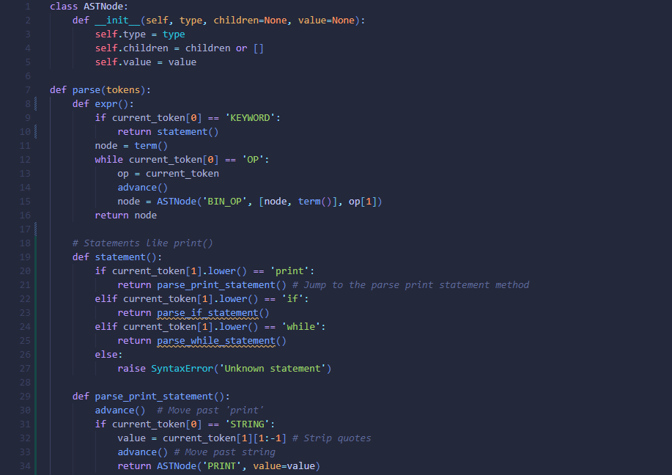
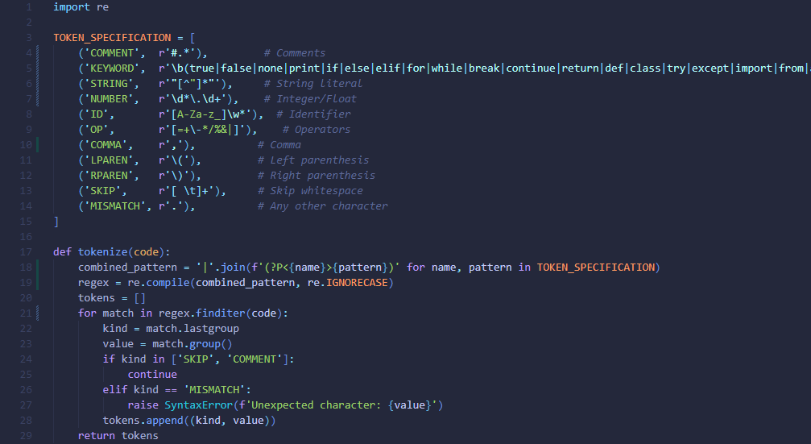
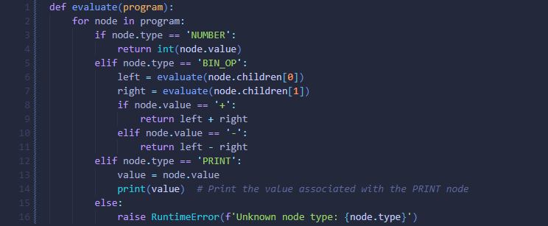
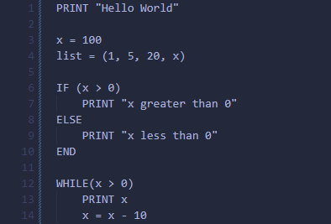
J.pyL Screenshots
Parser
Lexer
Interpreter

